Slide 1



.Tracking and Recognition.
of
.Activity Certificates and Events.

Slide 2
T R A C E

Slide 3
THE TEAM
A.Arman
A.Vishnu
Goutham .V.S
Narendran .M
Sangeeth .G.S
Under Guidance of Mrs.Shamna A.L.

Slide 4
INTRODUCTION.
TRACE is a website that provides an intuitive interface integrated with a database to store and manage various activity certificates and allocate points from a student end.
It provide a collective representation of the data in an organized format from a teacher’s end.
Manage and provide functionalities regarding an interactive telegram chat-bot for retrieval and updation of documents and data.

Slide 5
PROBLEM STATEMENT.
We currently lack a proper way to store and evaluate our activity points.
Certificates have been lost for various reasons by both students and issuers.

Slide 6
EXISTING SYSTEM.
There is no system in existence.

Slide 7
PROPOSED SYSTEM.
The proposed system will feature an intuitive and user- friendly interface that will enable students to collectively upload and manage KTU activity points based on their participation.
A common place to see all certificates and collected activity points.
This system can help students and teachers to yearly upload their certificates to KTU portal with ease.
Integration of a telegram support channel.

Slide 8
HIGHLIGHTS
Download all certificates as zip when necessary.
Telegram support for ease of use.
A tutor’s perspective on a collective representation of a class’s students’ activity points.
Displays points collected on a yearly basis.
Displays points collected based on the category of the event.

Slide 9
ABSTRACT.
The primary objective of this mini project is to develop a comprehensive web-based platform that enables the storage and management of various activity certificates, as well as the efficient management of each student's activity points based on their participation in events.
The application will also allow tutors to view as well as verify activity points accordingly.
Overall, the project seeks to streamline the certificate and activity point management process, making it easier for students, tutors, and administrators to manage and access their records.

Slide 10
PURPOSE.
The project seeks to streamline the certificate and activity point management process, making it easier for students, tutors, and administrators to manage and access their records.
It integrates the app with an interactive telegram chat bot for ease of uploading and monitoring of data for the user.

Slide 11
SCOPE
TRACE is a software system that aims to provide an intuitive interface integrated with a database to store and manage various activity certificates and allocate points from a student end.
TRACE aims to provide verification and a collective representation of the data in an organised format from the teacher’s end.
TRACE manages and provides functionalities regarding an interactive telegram chat-bot for retrieval and updation of documents and data.
The purpose of TRACE is to provide a comprehensive solution for managing student activities and data in an efficient and organised manner.

Slide 12
LITERATURE SURVEY.
TITLE | METHOD
Document Storage and Retrieval in a Neural Database[1] | A database of the leech nervous system has been developed. The end-users of the database will mainly be neuroscientists, especially those studying the invertebrate nervous system. It is mainly a document database, collecting papers on the leech nervous system, which is maintained in a largely automatic fashion. The database is composed of three subsystems: (1) an object-oriented, relational database management (sub)system, devoted to storing and maintaining the data and to provide input/output tools to the end-users;(2)

Slide 13
LITERATURE SURVEY.
TITLE | METHOD
Document Storage and Retrieval in a Neural Database[1] | a document understanding subsystem, which transforms paper documents into an electronic format which can be stored into the database; (3) an information retrieval subsystem, through which end-users extract information from the database. The actual system has been developed as a combination of original modules (the document segmentation module, the field extraction module, parts of the information retrieval subsystem, the user interfaces) with commercial products (the database management subsystem, the OCR module).

Slide 14
LITERATURE SURVEY.
TITLE | METHOD
Document Management as a Database Problem [2] | The article discusses various aspects of document management, including document acquisition, storage, retrieval, presentation, and processing of documents. The authors provide examples from the library system OMNIS/Myriad. The cost of document acquisition is the most important issue, but also the least addressed in building and maintaining large document bases. The article also discusses the architecture of document storage systems, storage hierarchies, network environments, and client heterogeneity.

Slide 15
LITERATURE SURVEY.
TITLE | METHOD
Document Management System, Open Source and Secure[3] | The proposed system will let the user scan, upload or import documents to the Document Management System. The system will facilitate compression without quality or data loss and provide authentication and authorization mechanism using OAuth and two-factor authentication. System will store the documents in PDF format at designated sever locations(cloud)and user can view documents within the system i.e. in Web Application. It will categorise files based upon Date etc.User can share files using links with password protection and limited time access.

Slide 16
MODULE DESCRIPTION
User Registration : Users can create accounts providing their college id, contact details and setting a password that fulfills the criterion.
UI Navigation : Provides different panes for viewing status, uploading documents and managing status and personal dashboard.Users can simply upload certificates selecting respected categories of events and let the app allocate maximum points allotted to the events by KTU guidelines.

Slide 17
MODULE DESCRIPTION
Feedback System : Users can submit suggestions, generate bug reports and the app itself will generate and manage accurate crash logs.
Support : The UI will be providing a separate help pane for quick tutorials and also provide customer support contact details.

Slide 18
ANALYSIS MODELS

Slide 19
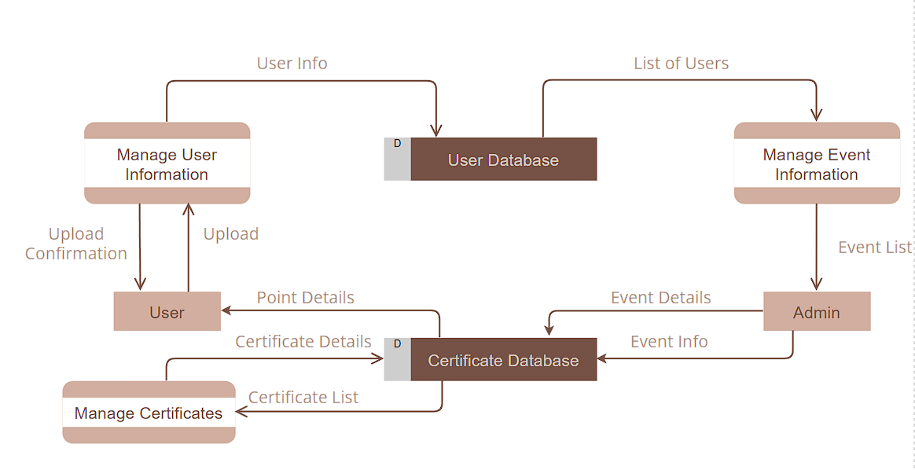
Flow Diagram

Slide 20
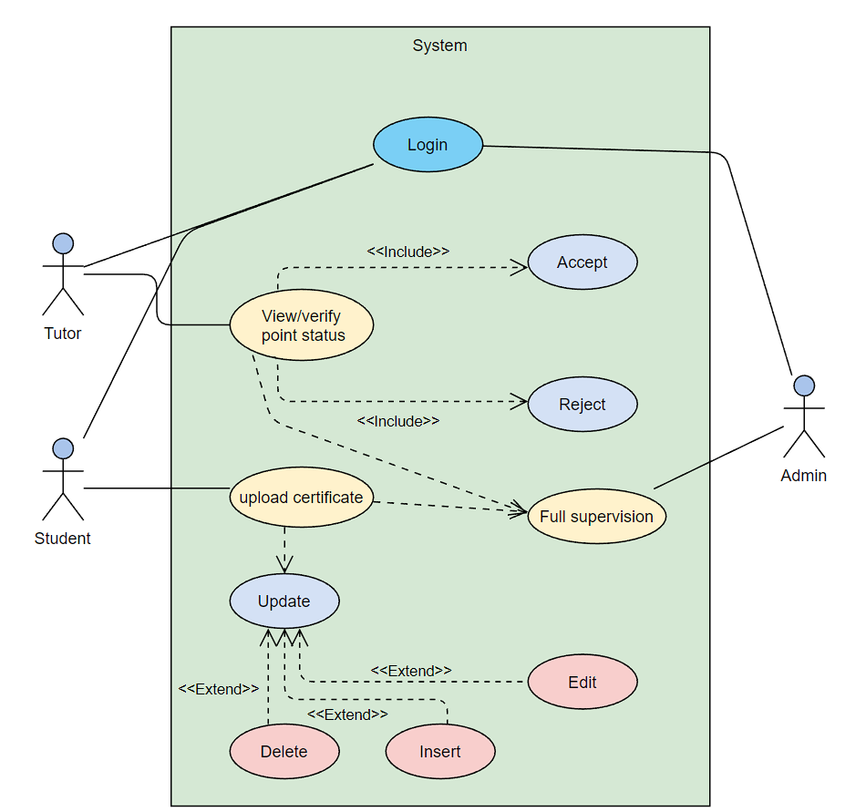
Use Case Diagram

Slide 21
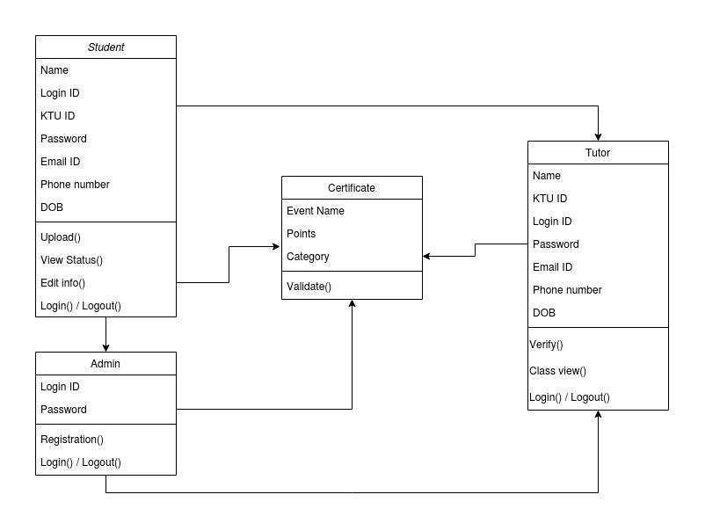
Class Diagram

Slide 22
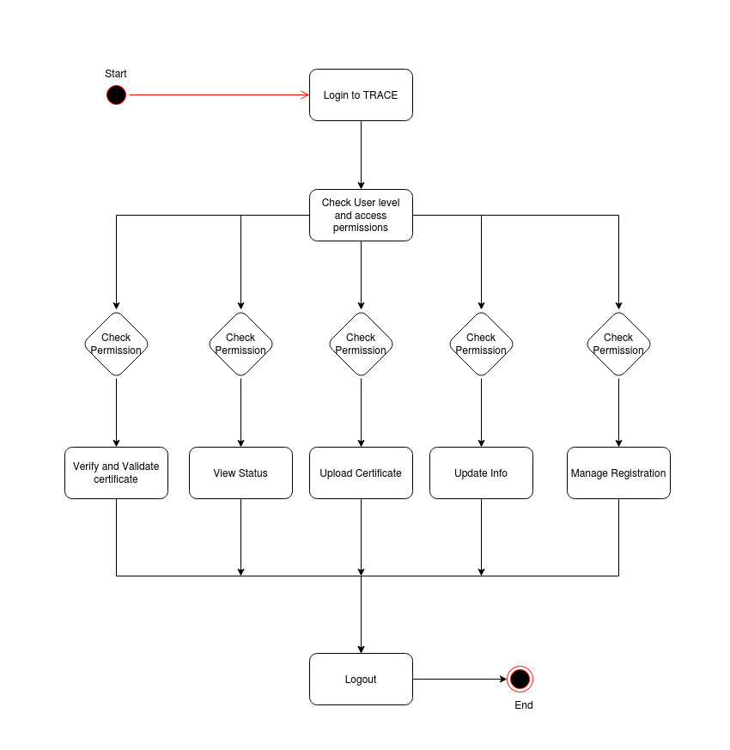
Activity Diagram

Slide 23
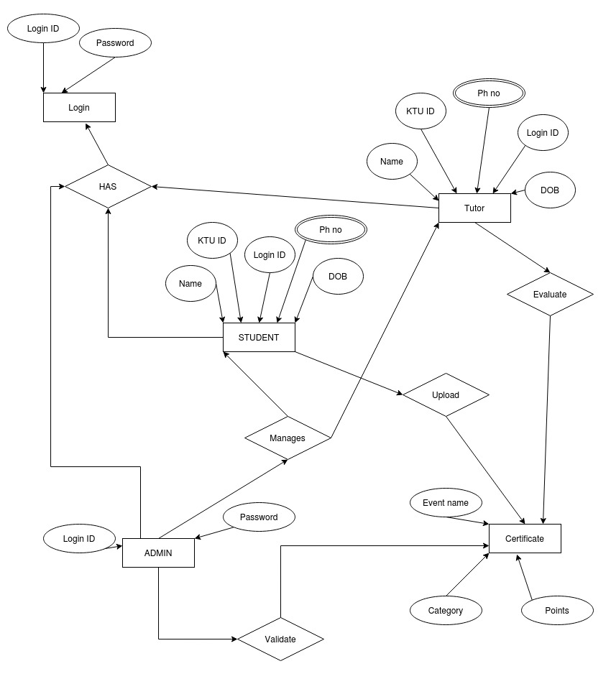
ER Diagram

Slide 24
REQUIREMENTS ANALYSIS

Slide 25
HARDWARE REQUIREMENTS.
●Computer with a 1.1 GHz or faster processor
●Minimum 2GB of RAM

Slide 26
SOFTWARE REQUIREMENTS.
Operating System : Any OS that supports web browser

Slide 27


LANGUAGES USED
FRONT END:
● HTML
● CSS
BACK END:
● MySQL and NoSQL
● PHP
● Javascript

Slide 28
FUNCTIONAL REQUIREMENTS.
Registration and Login for various individuals.
Uploading certificates by category.
Automatic calculation of activity points.
Manual correction and verification functions in Teacher’s login.
Basic functionalities accessible through telegram bot.
Batch download of certificates as zip.

Slide 29
RESULTS

Slide 30
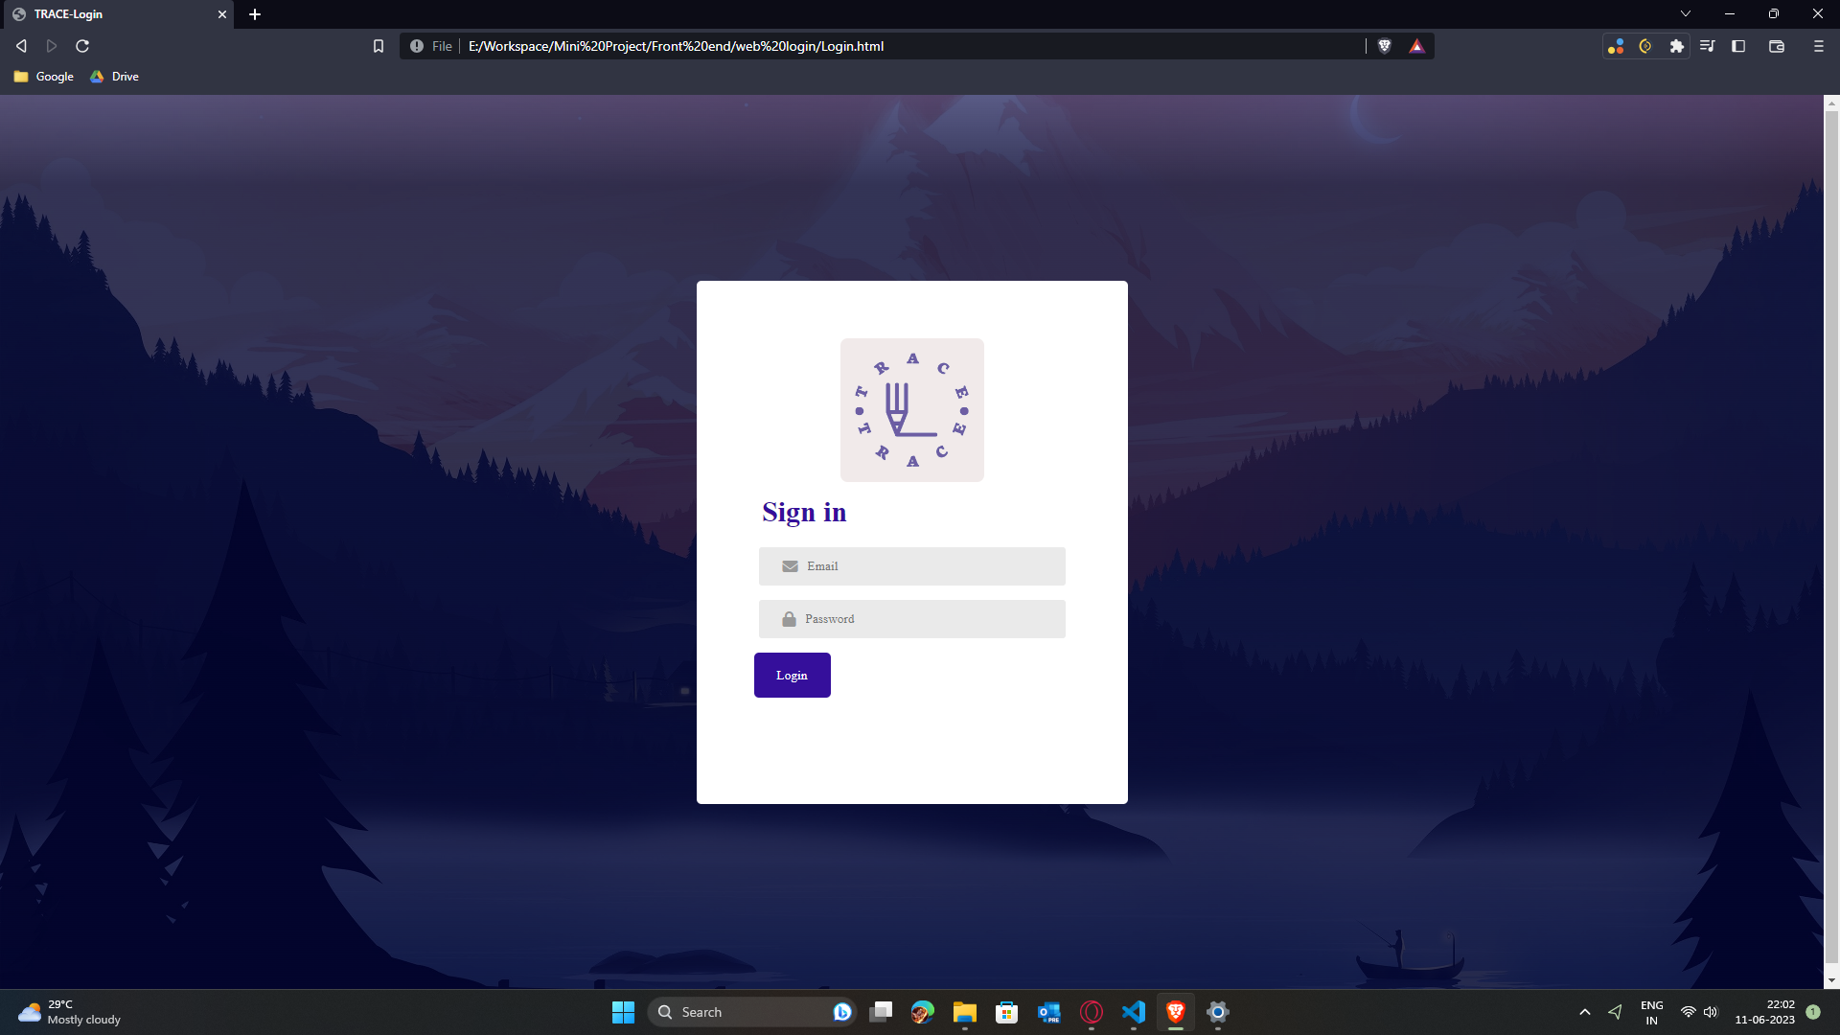

Slide 31
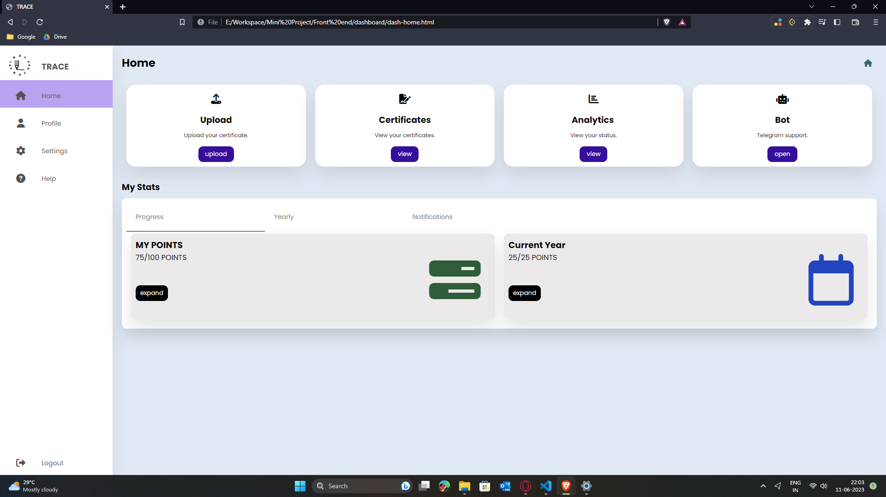

Slide 32
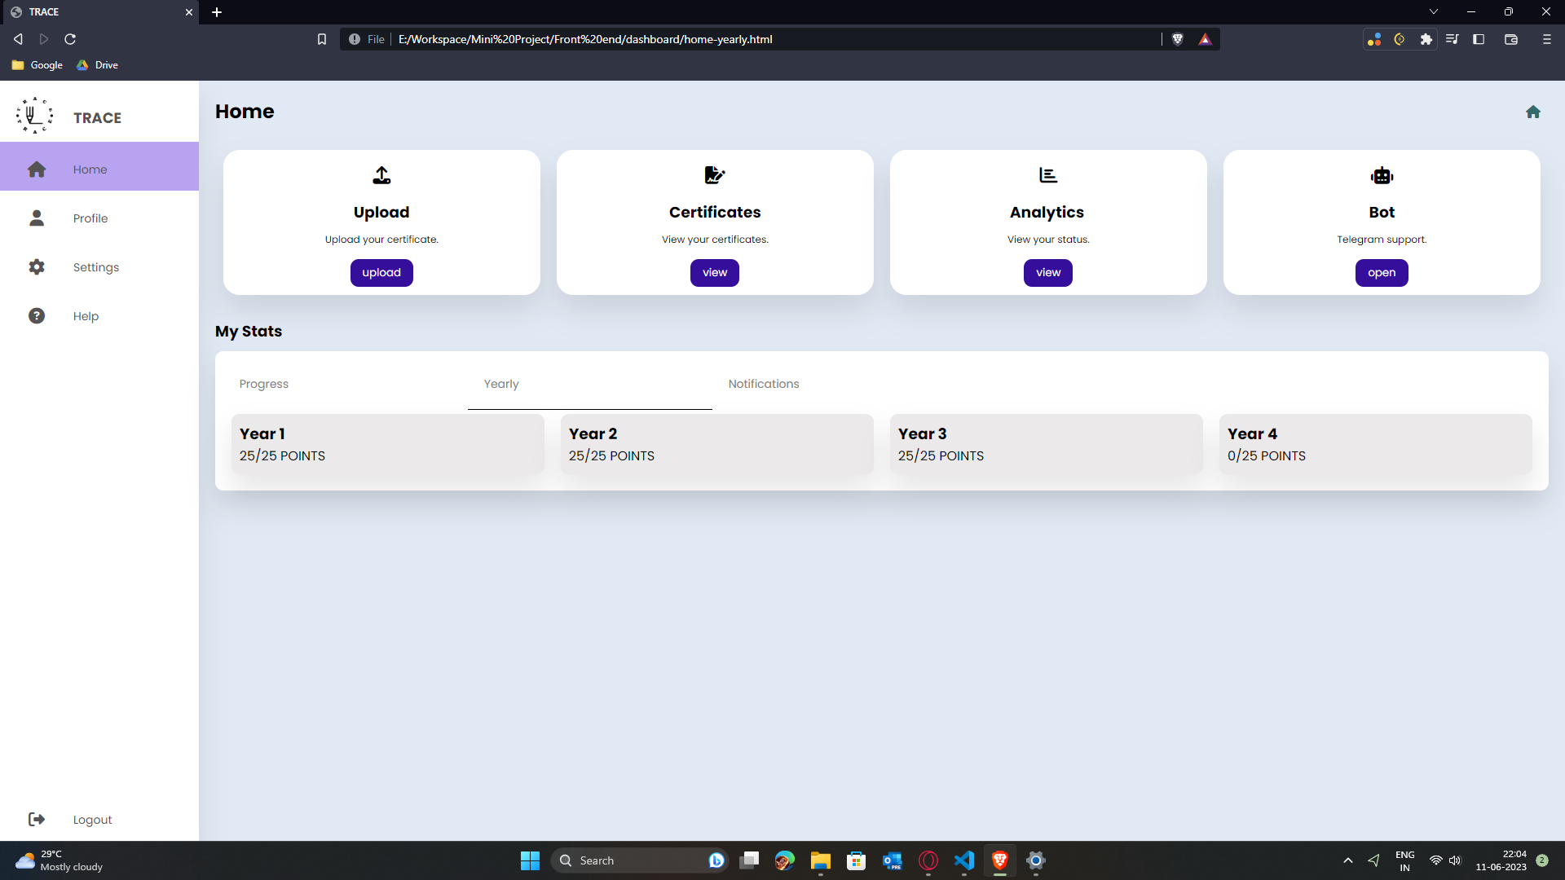

Slide 33
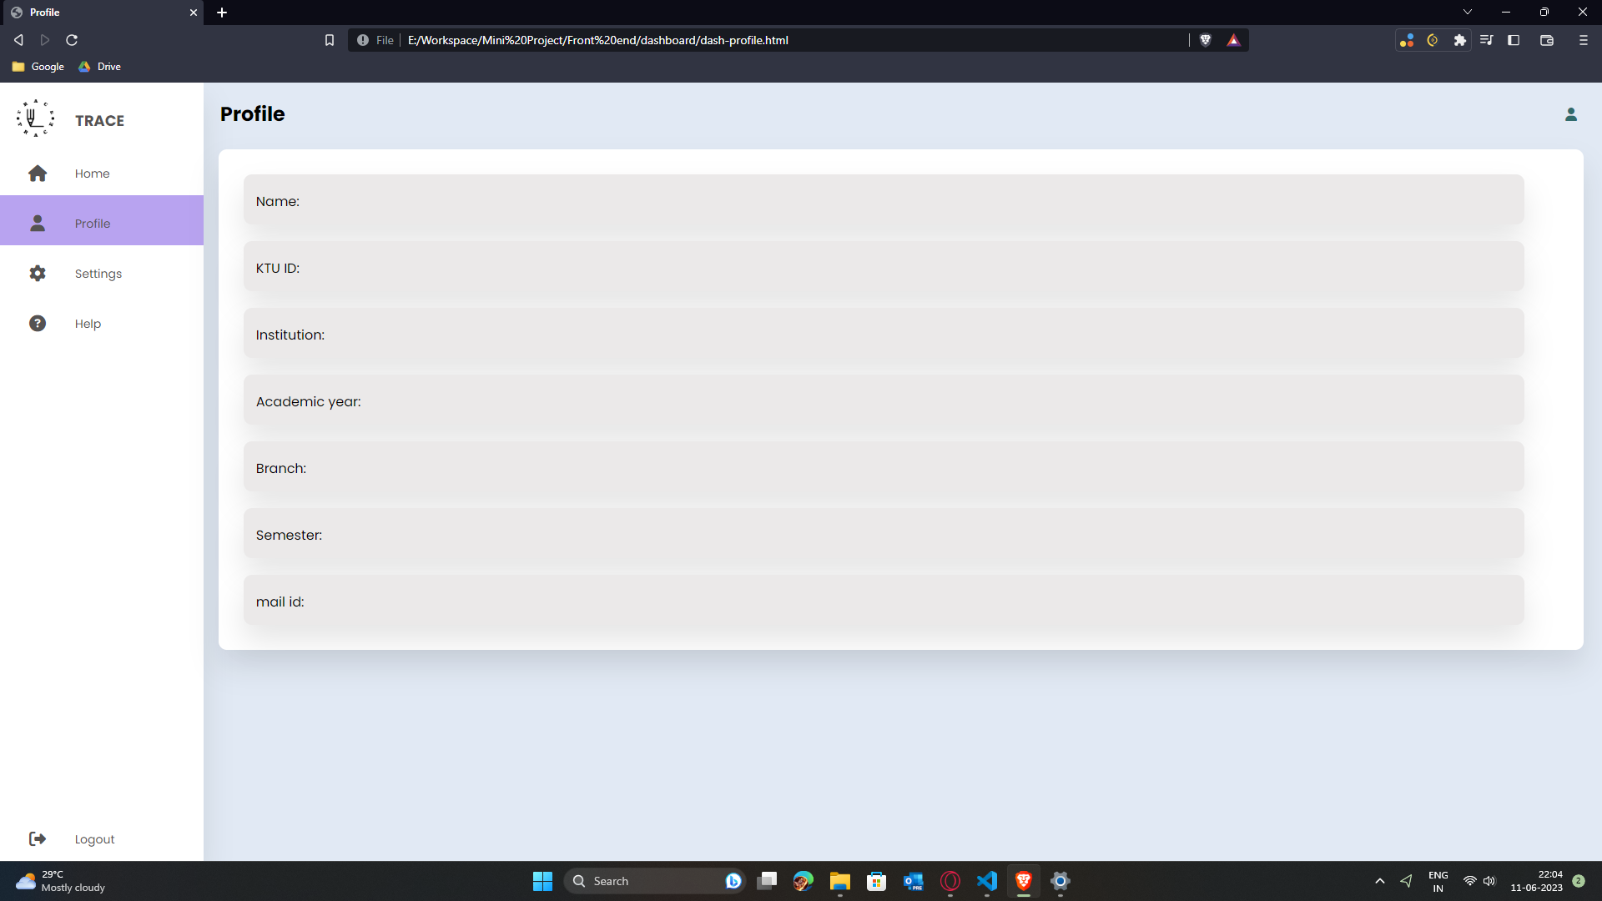

Slide 34
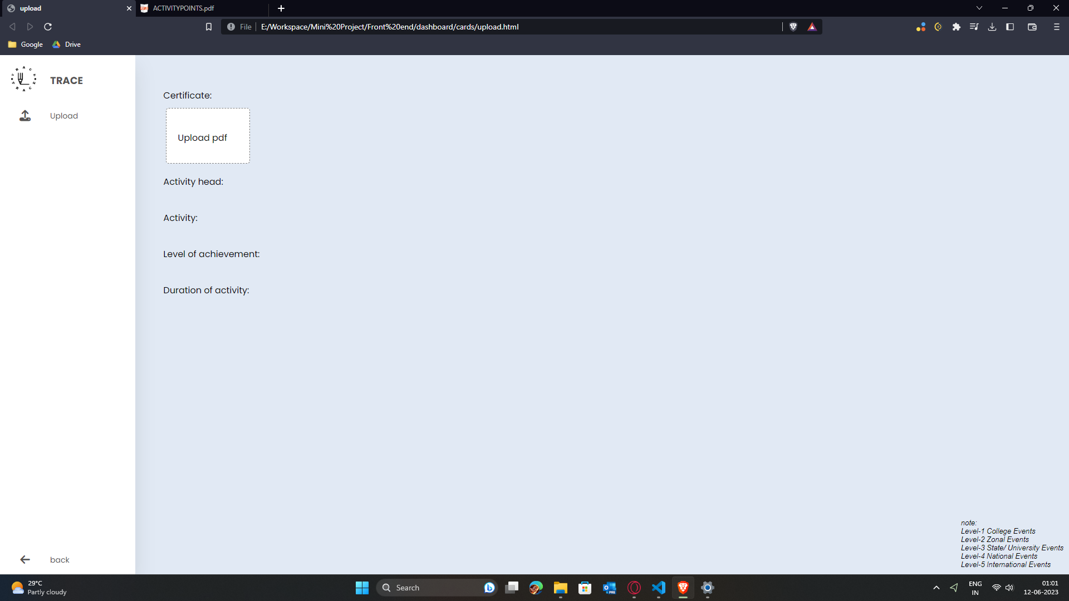

Slide 35
WHAT WE LEARNT.
We learned about the scope of application of HTML and CSS which were used to create the front-end of the web application.
JavaScript provides an interface for connection between front-end and back-end.
Then we learned about PHP which was used to fetch data from the database and transfer it over to the back-end.

Slide 36
FUTURE EXPANSION
A notifications section where news about various events happening in different colleges can be posted there.
A full-fledged telegram bot with even more functions.
By closely associating with colleges that conduct these events, we can provide an streamlined and efficient way for issusing certificates through the website.

Slide 37
CONCLUSION
Overall this project can streamline the process of how we manage various event certificates and help accumalate activity points in a well monitored manner.
This also helps tutors to view students’ certificates and upload them to KTU portal at ease.

Slide 38
REFERENCES
P. Parodi and G. Piccioli, A fast and flexible statistical method for text extraction in document pages, Proc. of the IEEE Conference of Computer Vision and Pattern Recognition (CVPR), San Francisco
Baxevanis, A. and Ouellette, B.F.F. Bioinformatics: A practical guide to the analysis of genes and proteins, John Wiley and sons, 1998

Slide 39
REFERENCES
Document Management System, Open Source and Secure : Shraddha More, Snehal Pagare, Shivani Pawar, Prof. S.K. Gondhalekar [e-ISSN: 2395-0056]
Tongjin Lee, Jun Iio Document Management System Based on ISAD(G), published in 10 December 2015 on IEEE Explorer.
V. L. Orlov, E. A. Kurako Electronic document management systems and distributed large scale systems, published in 16 November 2017 on IEEE Explorer.

Slide 40
THANK YOU!!.

